Slide 1

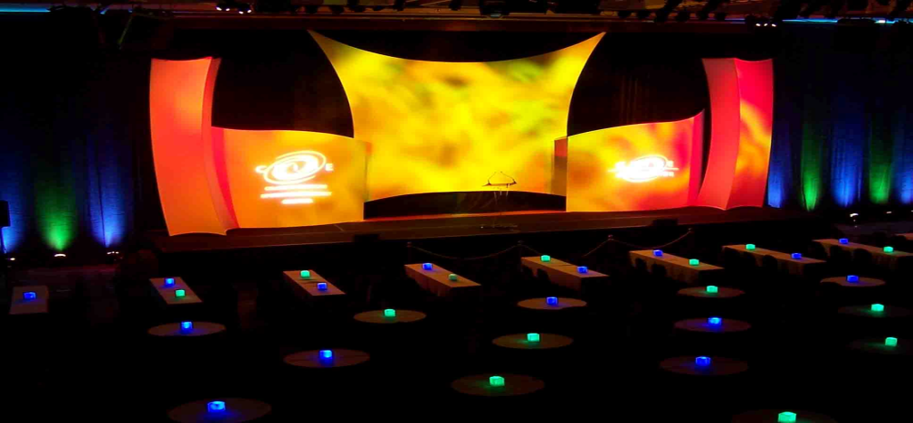



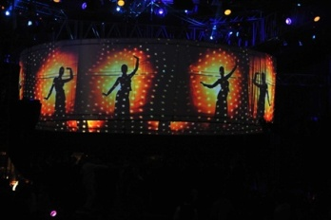
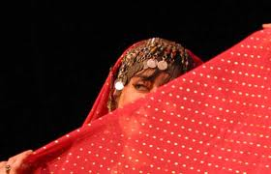

















Comedy Shows
Product launch&company Launch
Cultural Evenings
Convocation
Rock Shows
Live Concert
Rock Shows
Rock Shows
Debate
Debate
Fashion Shows
Talent Hunt
Seminars & Workshops

Slide 2


The
Company
Located in NOIDA, GVR Media Arts Pvt Ltd. (GVRMAPL) is an Event Management Company with an aim to provide highest standard of service. We specialize in, complete event planning, production and project management of programs by delivering expert integration of the major business disciplines. The end-results enable our clients to better inform, entertain, motivate and reward their target audiences.
We are committed in providing a comprehensive and successful production. Because of this we are able to bring first time inquirers, as well as seasoned promoters, a profitable outcome for their venue, corporate party, fundraiser, festival, Conferences and meetings or any special event. We assist clients to accomplish their corporate communications objectives and maximize their shareholder value.

Slide 3


Our
Team
Team
Our team is a rare mix of professionals with rich experience in event execution.
Having worked on the client side too we know the pain points and ensure smooth and seamless execution.
The core production team members are ex-shobiz, and are known for their professionalism.

Slide 4



Mission
Vision,Values
Mission
Taking pride in what we do and the people we serve will be and is how we define ourselves.
We are committed to maintaining customer satisfaction, trust and integrity by delivering quality products and services conforming to industry best practices and continuous process improvement.
”We serve others as we would like to be served“

Slide 5



Mission
Vision, Values
Vision
Our Vision is to emerge as a dynamic, techno-savvy, customer centric, progressive and reliable event management company, working in an environment of professionalism, trust and transparency, observing highest standards of event management and corporate social responsibility, meeting the expectations of all its clients as well as the aspirations of its employees.

Slide 6


Mission
Vision,Values
Values
Integrity
Solutions
Authenticity
Passion
Teamwork
Excellence

Slide 7
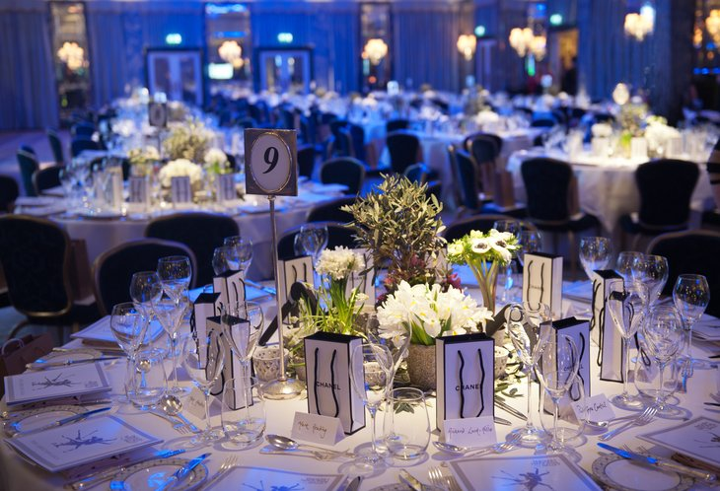

Corporate Events
Work Profile
Company Launch
Brand & Product Launch
Seminars & Workshop
Conferences & Meetings
Trade Fairs & Exhibitions
Marketing Events

Slide 8


Special Events
Work Profile
Work Profile
Celebrity & Artist Management
Fashion shows
Live performance & Concerts
Pub Activities
Exhibition
Personality Development & Consulting

Slide 9
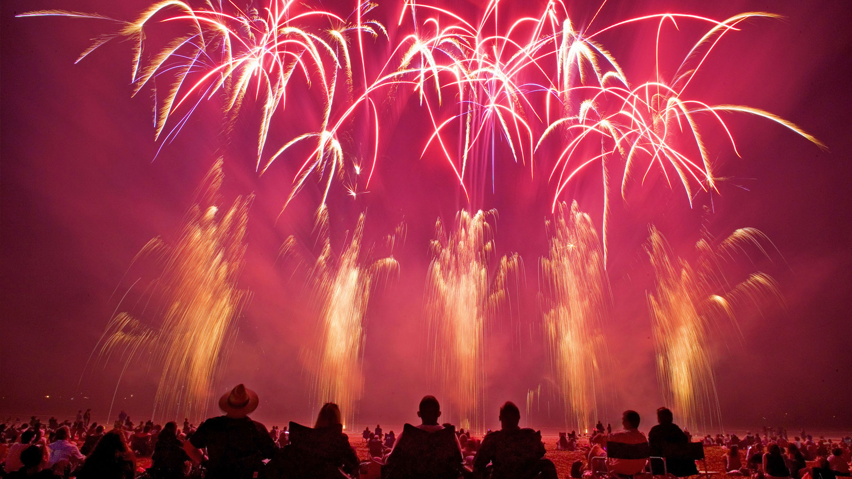

Events Done
Work Profile
Annual Day Celebrations
Brand Launch Of Bagpiper
Brand Promotion Of Philips
Convocation Program
for various Colleges
Cultural Evenings
Festival Celebrations
National Conference of
ICAI
Road Show- Idea
Recreational Activities
Talent Hunts Shows
Various College Fest
Various Conferences
Various Fashion Shows
Various Job Fairs
Various Pub Activities
Various Showroom Décor
Workshops

Slide 10


Clients
Clients
Beekaya Reality India Pvt Ltd
Broadway Infotech. Pvt Ltd.
Candid Software Pvt Ltd.
Dance Worx
Tapasya Projects Ltd.
Headstrong India Pvt Ltd.
Network Security solutions. (I) Ltd.
Mindmill Software Ltd.
Scicom Technologies Pvt Ltd.
SDG Software India Pvt Ltd.
Morpheus Pro Developers Pvt Ltd.
Unnati Fortune Holdings Pvt Ltd.
Techsol Information Technology Pvt Ltd.
Masu Breaks Pvt Ltd.

Slide 11


Our
Clients
Clients
Software Data India Ltd.
Expo Media
Waves NOIDA
Mystica Music
U Flex India Ltd.
Nippon Audiotronix Ltd
Motherson Group
The Catalyst Group
Nature Gen Technologies Pvt. Ltd.
Skoda Powers Pvt Ltd.
Indian Technomac Company Ltd.
Reliable Institute of Law And Management
Kamkus College of Law (Bhagirath Seva Sansthan)

Slide 12


Clients
Our
DS Groups
ITC wills Lifestyle
Lacoste
Manu Maharani Hotels Ltd.
Radico KhetanLtd.
PVR Cinema Pvt Ltd.
Regency Creation Ltd.
Sarita Couture House Pvt Ltd.
Nehru World School
Sara India Reality
The Institute of Chartered Accountant Of India
Janhit Institute of Education And Information
Inverster s Clinic

Slide 13


Our
Anchor
Artist
P
Ada Khan
Ali Asgar
Aman Verma
Amrita Tripathi
Anubha Bhosale
Ayushmann Khurana
Bani
Cyrus Broacha
Divya Jaitely
Hussain
Jay Bhanushali
Kanupriya
Neha Mehta
Manish Paul
Rakshanda Khan
Stuti Nagpal
Sheena Chauhan
Shamsher Rai Luthra
Simran Kaur Mundi
Neha Mehta
Rhea
Sailesh Lodha
Thanvi Mittal

Slide 14


_{Our}
Celebrities
Artists
Chetan Bhagat
Dhristi Dhami
Kamya Punjabi
Karan Kundra
Krishna Tirath
Mahi
Pooja Gaur
Ranvijay
Ratan Rajput
Ritu Beri
Rohit Verma
Roshni Chopra
Sambhavana Seth
Sonali Bendre
Sanjana Jhon
Sanjeev Kapoor
Shipra Khanna
Shweta Tiwari
Sumona Chakravarty
Tanushree Dutta
Toral
Upasana Singh
Veena Mallik
Vikas Khanna

Slide 15


DJ’s
_{Our}
Artists
@ce
Akbar Sami
Aks
Aqeel
AYK Official
Beet2
Bibhas
Brute Force
Emwe
Ishani
Midival Punditz
Myk
Nasha
Pearl
Progressive Brothers
Reaktiv Sound
Rhyzok
Smilee
Sound Avtar
Swap
Vikk
Willy

Slide 16


_{Our}
Dance Troupe
P
Artists
Aaja Nachle Dance Institute
Aasma Dance Company
Antanyas Dance Academy
Cool Punjabi folk Dance Troupe
Dance Studio Noida
Dare Dazzle
Folk Dance Group
GPD Dance Troupe
Hotstepper Dance Troupe
Madhuban Dance Troupe
Mauja Hi Mauja
Mauj Panjab DI (MPD)
Rhythm Craft Academy
Rockstar Dance Academy
Royal Dance Troupe
Scorpions Performing Art
Shiamak Daver Dance Troupe
Street Dance Academy
Stunners Dance Academy
Terence Lewis Academy
The Dance Worx
Vibration Dance Troupe
Zenith Dance Troupe

Slide 17
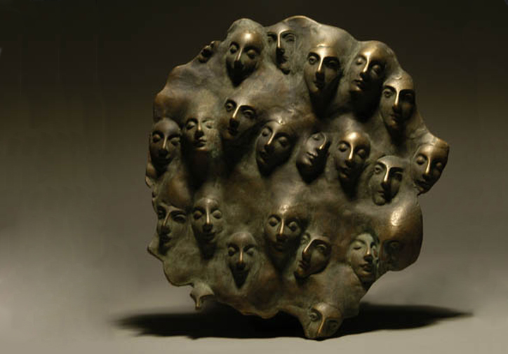

Our
Comedians
P
Artists
Bharti Singh(Lalli)
Deepak Saini
Deepak Singh
Dheer Kumar
Ehsaan Qureshi
Ganga Thakur
Kapil Sharma
Krishna
Khyali
Papa CJ
Paresh Ganatra
Rakesh Bedi
Rajeev Malhotra
Rajnish Trivedi
Rehman Khan
Rohan Joshi
Saami
Saurabh Pant
Shiraj Khan
Sudesh Lehri
Sughandha Mishra
Sunil Pal
Tanmay Bhatt
Tiku Talsania

Slide 18


Our
Singers
Artists
Akshma Chaudhary
Amanat Ali
Anu Singh
Bohemia
Daler Mehandi
Gargi Verma
Garry Sandhu
Guru Randhawa
Harbhajan Mann
Honey Singh
Jas Raaj
Jasbeer Jassi
Jubeen Garg
K Kishore (Nadeem )
Kailash Kher
Mika Singh
Rahul Vaidya
Raja Hassan
Roohani Sisters
Richa Sharma
Sheena Chawla
Shibani Kashyap
Shubhangi Tiwari
Sukhvinder Singh
Vineet
Ujjani Mukharjee

Slide 19

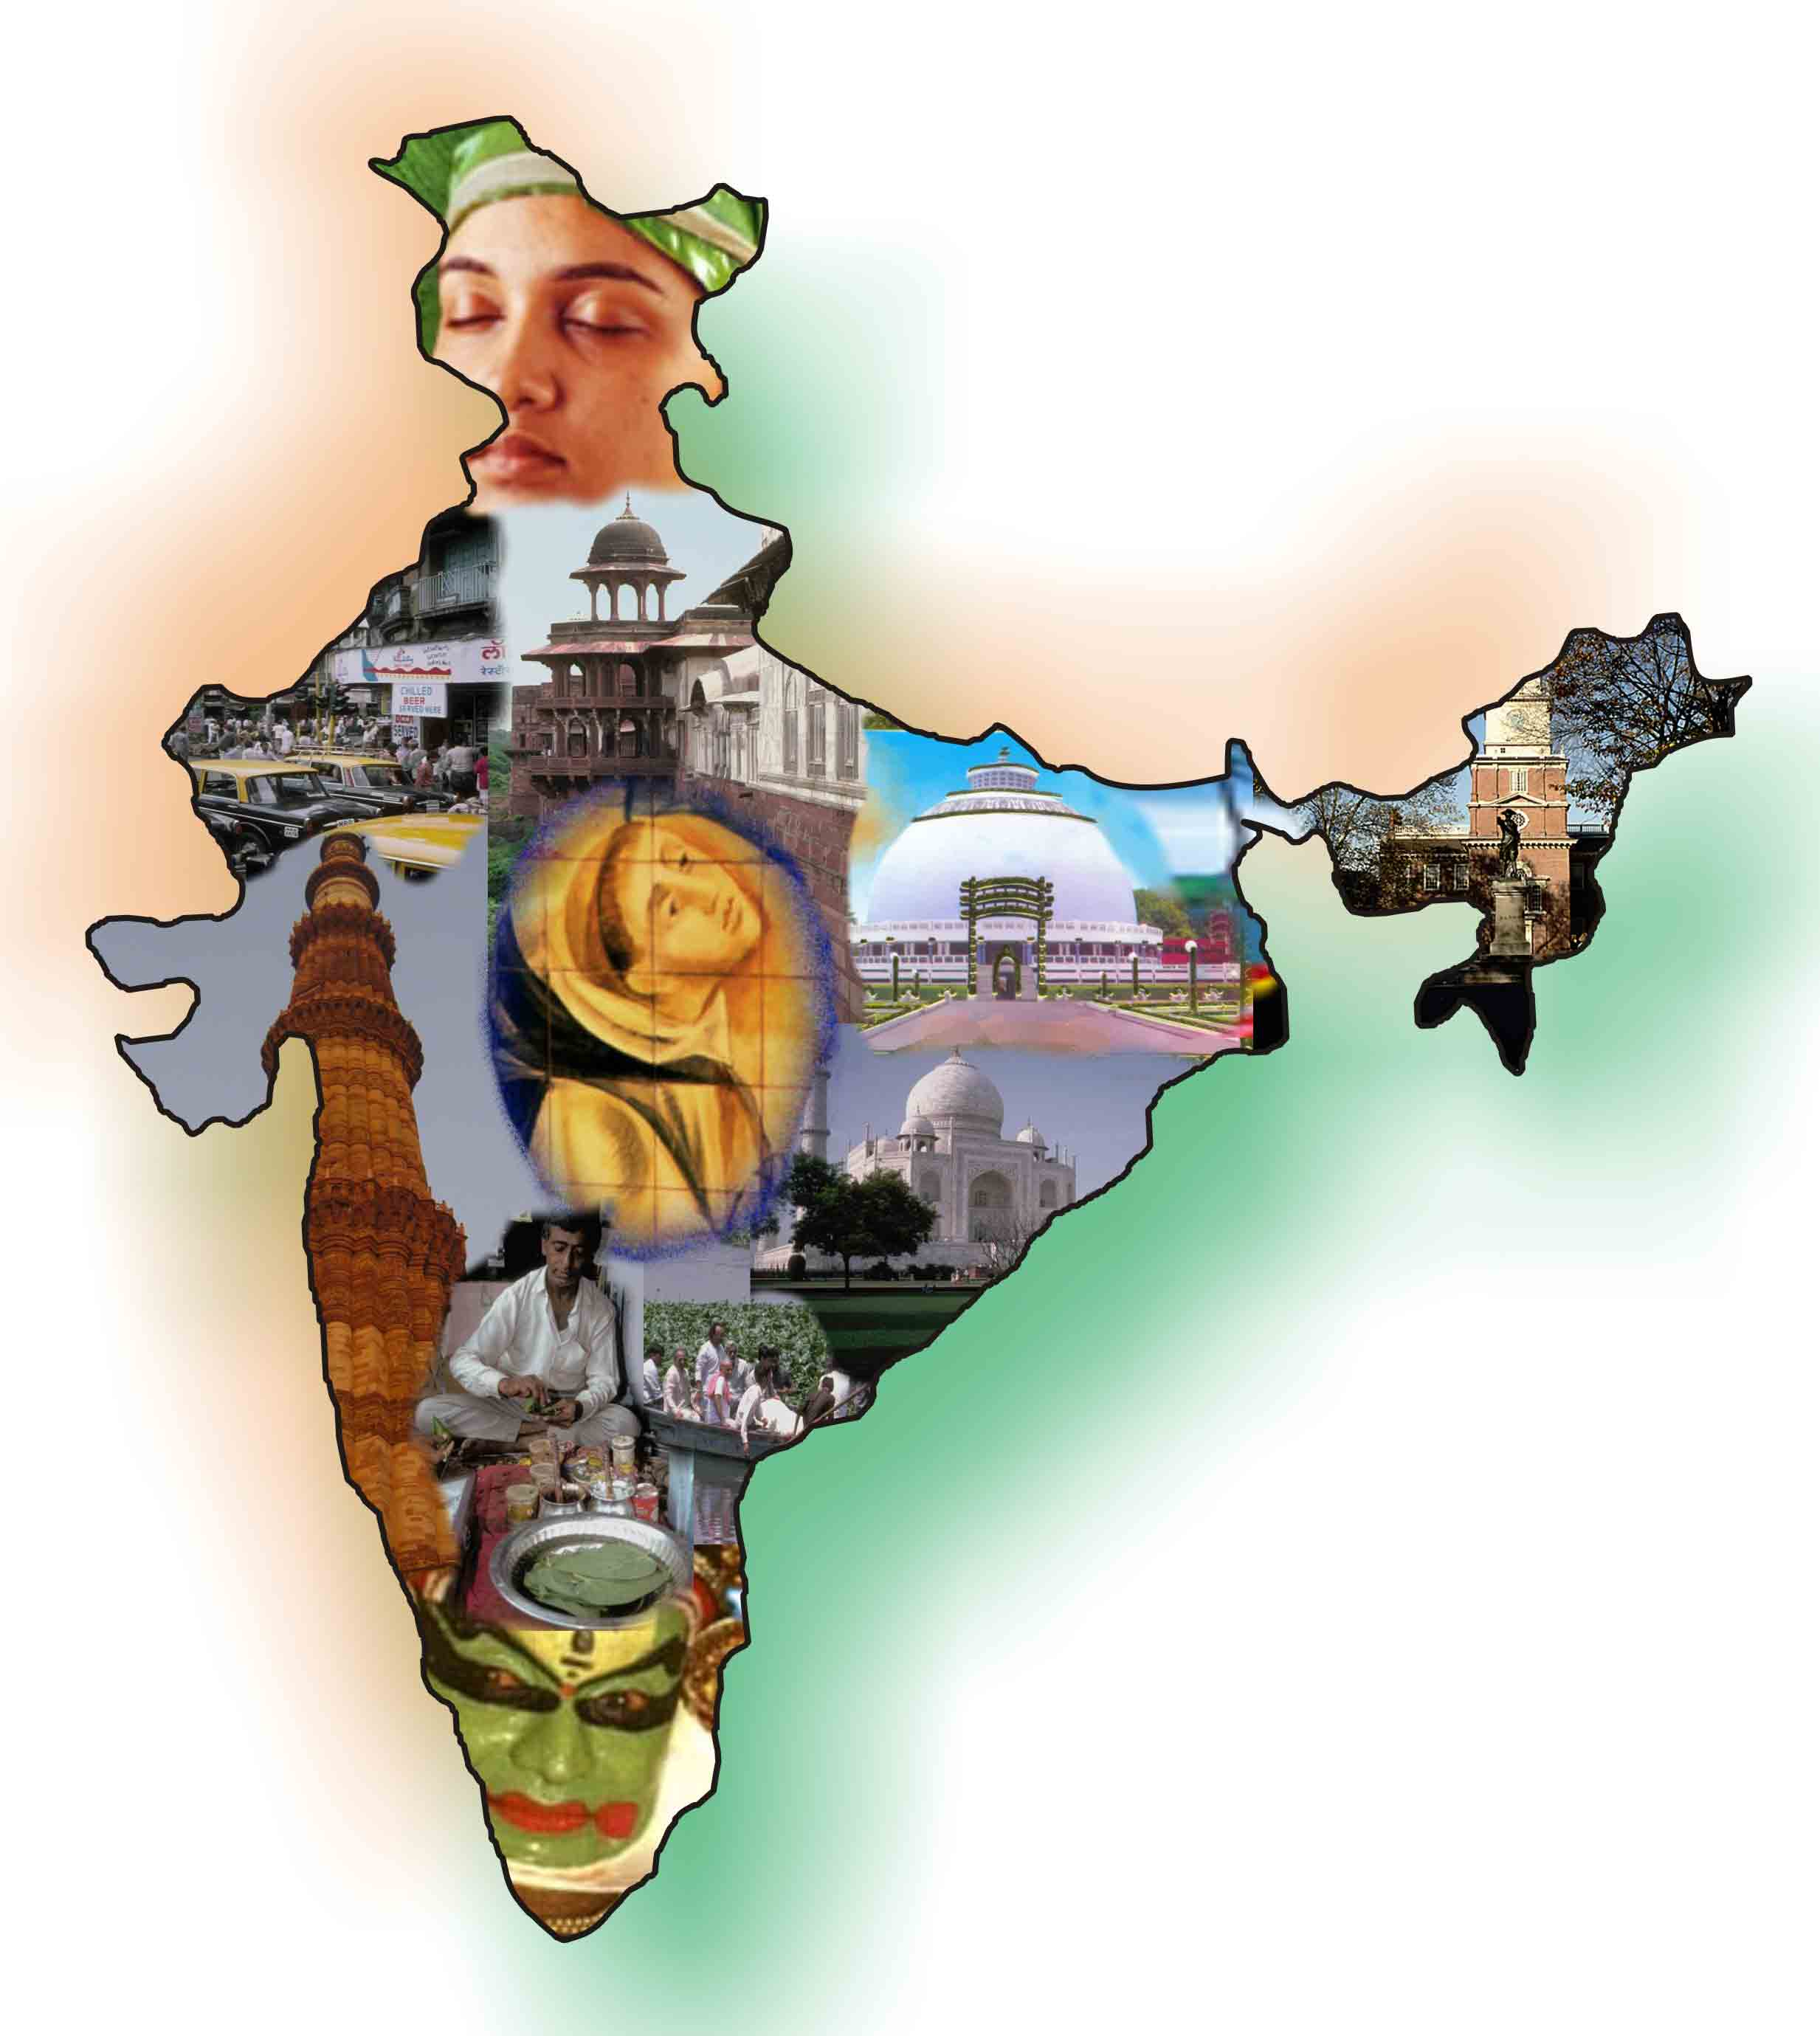
_{Work}
Locations
Location

Slide 20


_{Work}
Contact Us
Contact Us
Corporate Office:
GVR Media Arts Pvt Ltd.
A-58, Sector 65
NOIDA- 201301
Mob: +919313353030/+91120-4278150
Branch Office:
Royal PG College Campus
Opposite Gate No. 06 - Vidhan Sabha
Near Pratibha Cinema, Hazratganj
Lucknow-226001
Mob: +919582683407;+919560593066
Website: www.gvrindia.in
Email: hr@gvrindia.in

